Slide 1
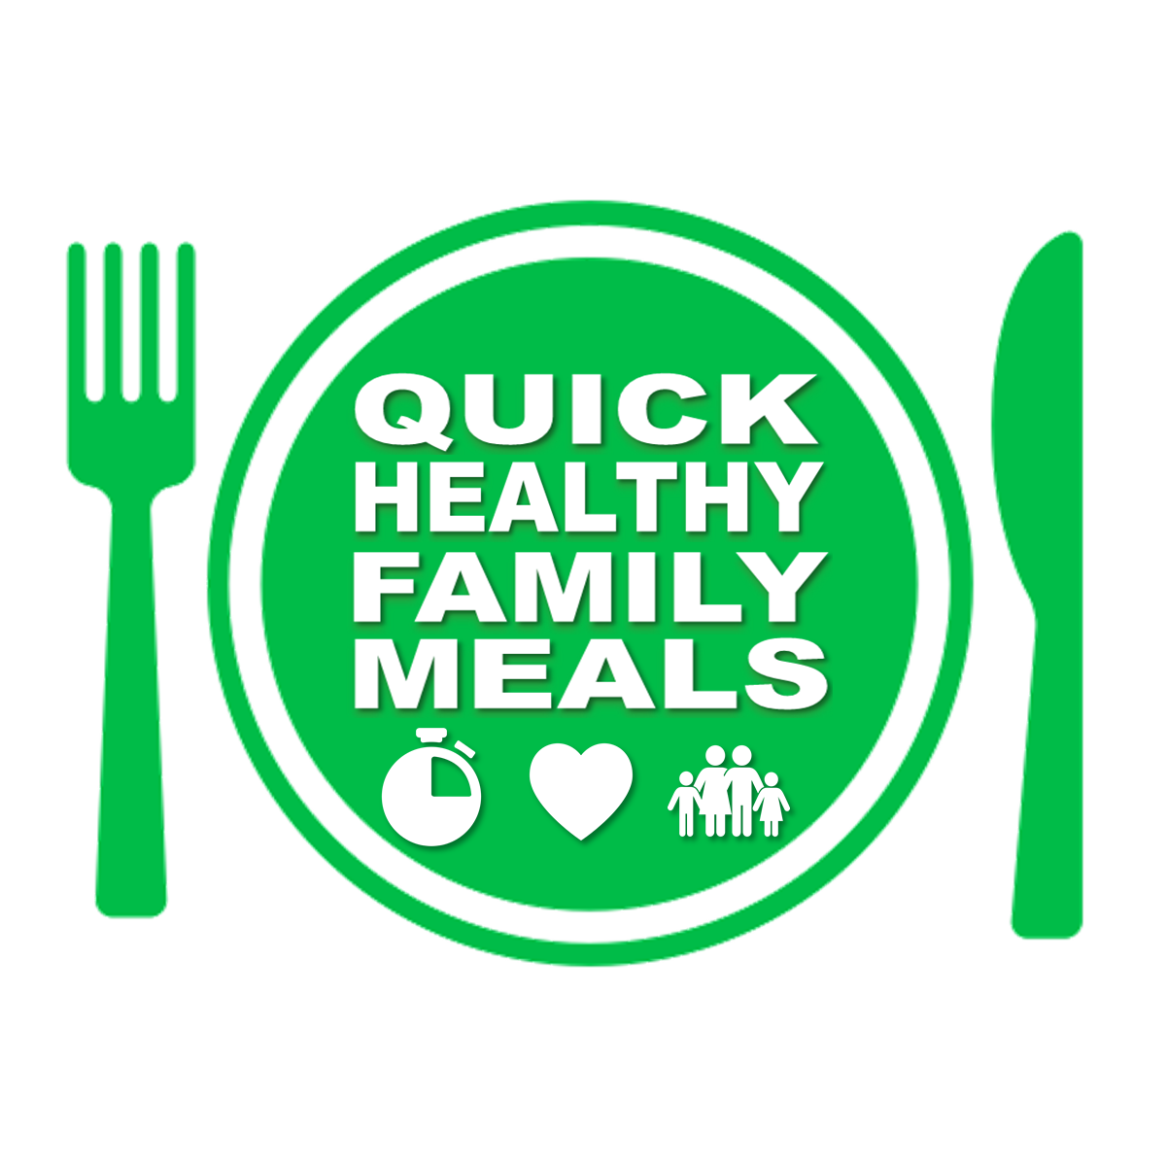
MINESTRONE SOUP
QUICK
HEALTHY
FAMILY
MEALS
15 mins
Red kidney beans contain Vitamin B1 which helps the body break down and release energy from food.
Feeds 7-8
This soup is a complete meal
INGREDIENTS
100g little pasta stars (or similar)
1 large onion
¼ head of cabbage
3 stalks celery
2 medium carrots
2 garlic cloves
1 x 400g tin red kidney beans
½ - 1 x 400g tin chopped tomatoes*
3 tbs tomato paste*
1 tsp paprika
¼ tsp cayenne pepper (if you like a kick!)
2 stock cubes dissolved in 1.5 litres water
S&P
* The tomato is hard for me to get exact. Some of my family have a bit of a thing against tomato soup so they like it less tomato-ey. I like the tomato. So adjust the quantity to how your family like it.
METHOD
Put pasta onto cook – drain when cooked
Dice your onion
Heat 1 tbs oil in a large saucepan
Add onions and sauté whilst you prep your other veg
Mince and add the garlic
Chop the rest of your veg and add it as you go along – celery, carrot & cabbage.
Add the paprika (& cayenne if using)
Add the stock, drained kidney beans & chopped tomatoes and bring to the boil, then simmer for 5 mins.
Add the cooked drained pasta
Taste, add salt and pepper if necessary and serve
TOP TIP !
Feel free to swap veggies…you could add courgettes, sweetcorn, greens, peas, pepper etc
@quickhealthyfamilymeals
To watch a video showing how this is made or to explore more
Quick Healthy Family Meal ideas go to www.quickhealthyfamilymeals.com

